Slide 1

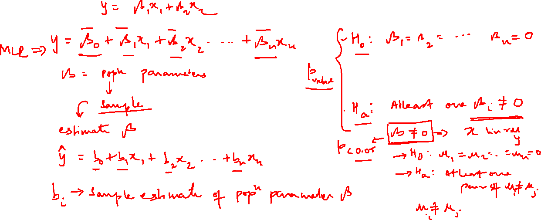

Slide 2
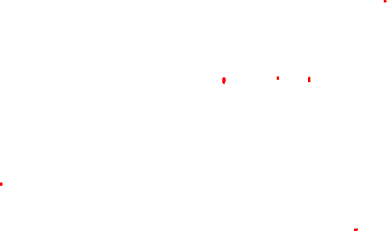
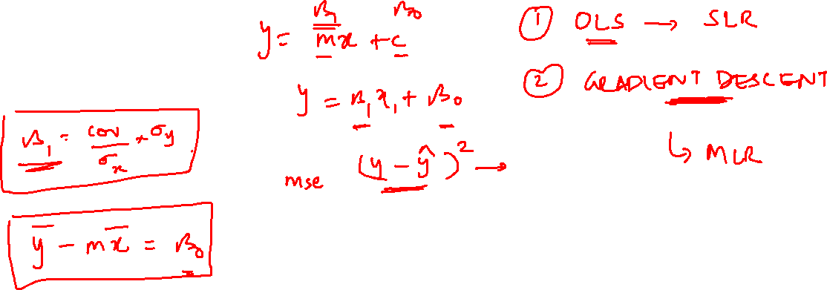

Slide 3
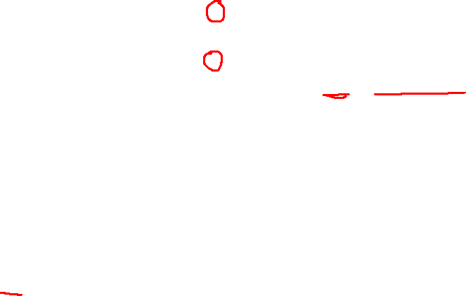
R- Squared
1 → Total Error
2 → Error reduced by Regression Line
3 → Residual Error
R² = SSR / SST
SSR = Regression Sum of Squares
SST = Total Sum of Squares
Higher the R² better the model

Slide 4
